Slide 1
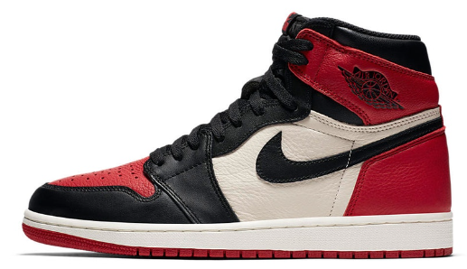

BrandLab
CLOTHING STYLE BRAND CLOTHING STYLE BRAND CLOTHING STYLE BRAND CLOTHING STYLE BRAND
Team Member
Brandon Yeap
Yong Cheng Shen
ND 1980 CLOTHING STYLE BRAND 1980 CLOTHING STYLE BRAND 1980 CLOTHING STYLE BRAND 1980 CLOTHING STYLE BR

Slide 2
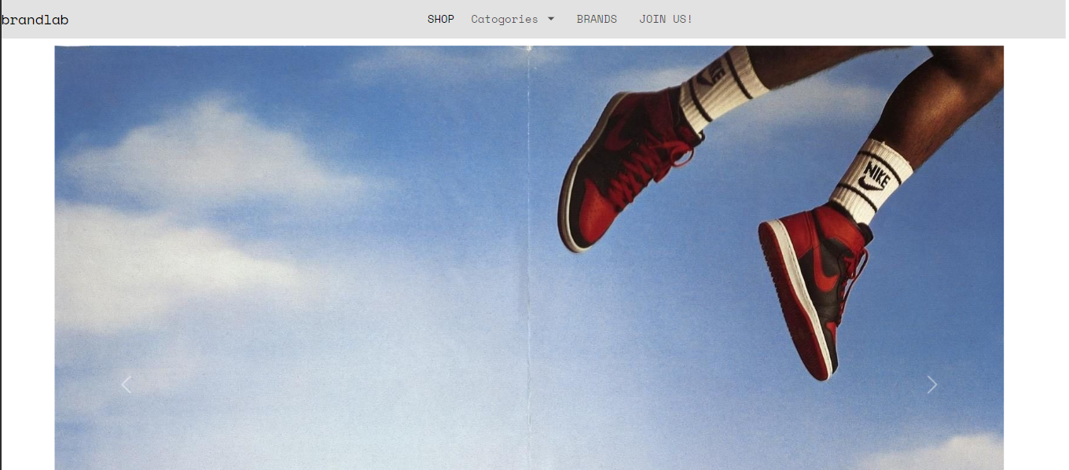
Introduction
1980 CLOTHING STYLE BRAND 1980 CLOTHING STYLE BRAND 1980 CLOTHING STYLE BRAND 1980 CLOTHING STYLE BRAN
ND 1980 CLOTHING STYLE BRAND 1980 CLOTHING STYLE BRAND 1980 CLOTHING STYLE BRAND 1980 CLOTHING STYLE BR

Slide 3



Frameworks used

Slide 4
Objectives
1980 CLOTHING STYLE BRAND 1980 CLOTHING STYLE BRAND 1980 CLOTHING STYLE BRAND 1980 CLOTHING STYLE BRAN
Increase Sales
Expand Customer Base
Enhance Brand Awareness
Improve Customer Engagement
Achieve Sustainable Growth
ND 1980 CLOTHING STYLE BRAND 1980 CLOTHING STYLE BRAND 1980 CLOTHING STYLE BRAND 1980 CLOTHING STYLE BR

Slide 5
Website in different type of device

Slide 6
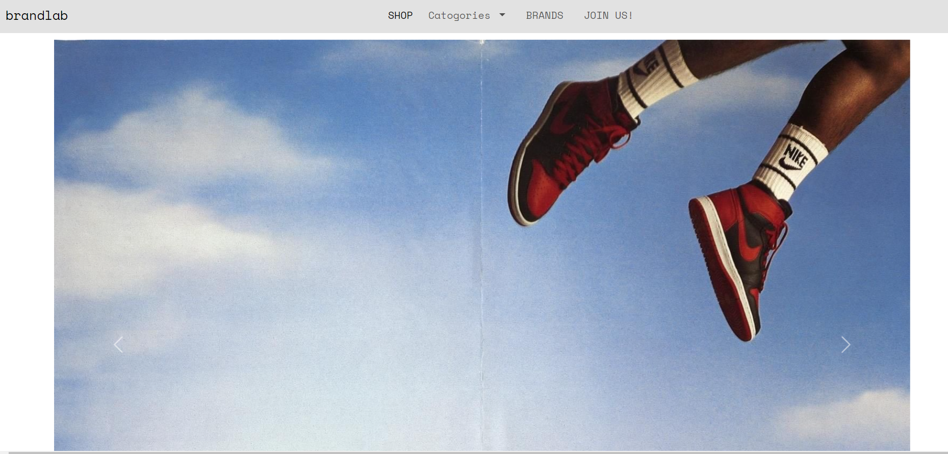
Desktop

Slide 7
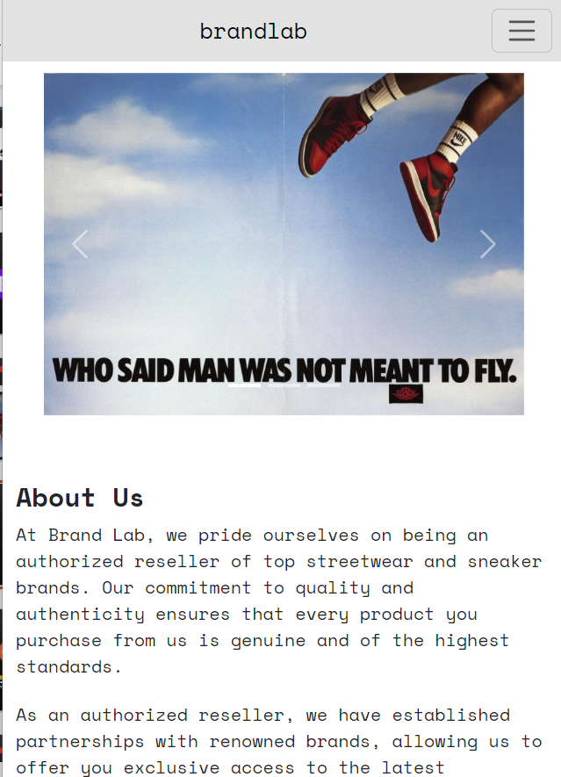
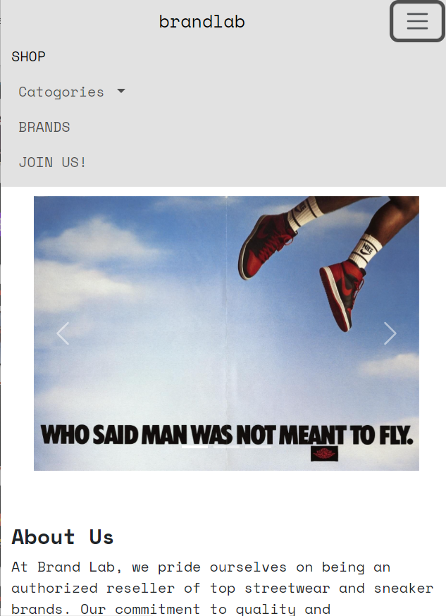
Phone

Slide 8
Bootstrap
1980 CLOTHING STYLE BRAND 1980 CLOTHING STYLE BRAND 1980 CLOTHING STYLE BRAND 1980 CLOTHING STYLE BRAN
A powerful front-end framework for developing responsive and mobile-first websites.
With Bootstrap's ready-to-use components and responsive grid system, we can quickly build prototypes and production-ready websites.
ND 1980 CLOTHING STYLE BRAND 1980 CLOTHING STYLE BRAND 1980 CLOTHING STYLE BRAND 1980 CLOTHING STYLE BR

Slide 9
Homepage
1980 CLOTHING STYLE BRAND 1980 CLOTHING STYLE BRAND 1980 CLOTHING STYLE BRAND 1980 CLOTHING STYLE BRAN
ND 1980 CLOTHING STYLE BRAND 1980 CLOTHING STYLE BRAND 1980 CLOTHING STYLE BRAND 1980 CLOTHING STYLE BR

Slide 10
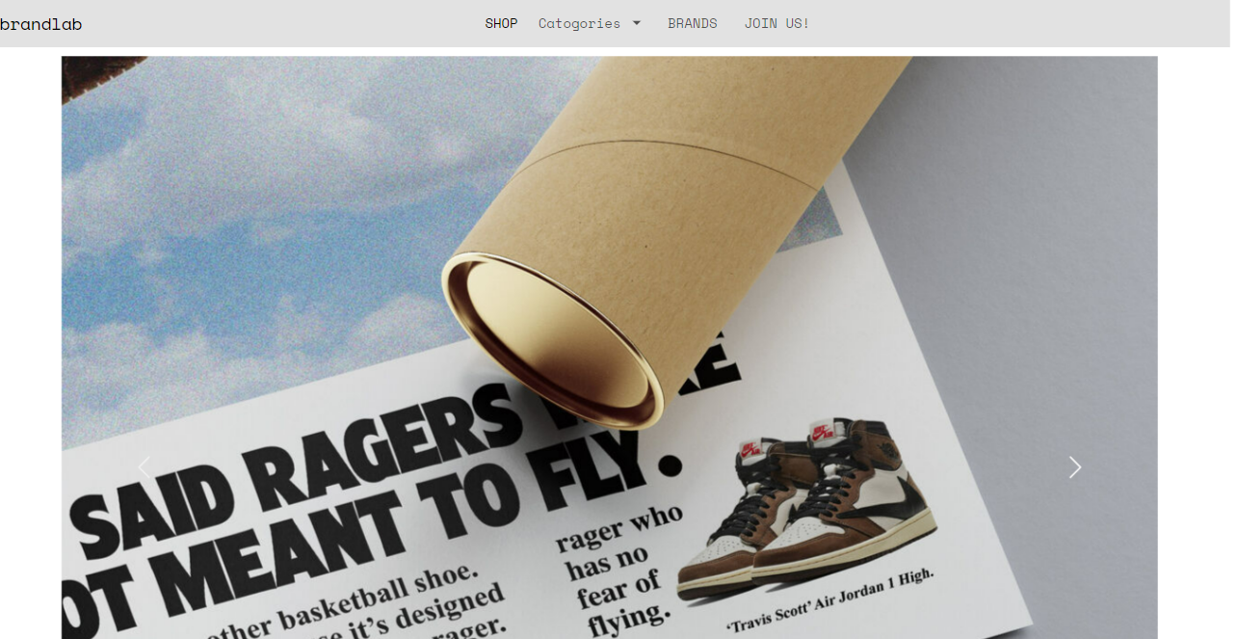
Bootstrap - Navbar

Slide 11
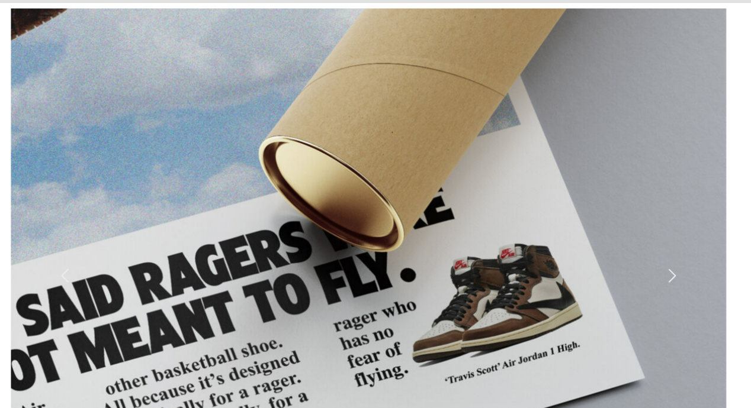
Bootstrap - Carousel

Slide 12
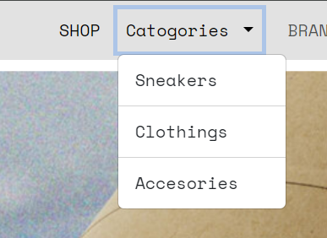
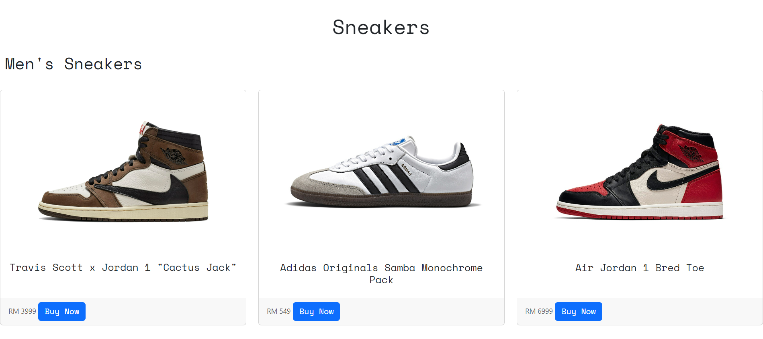
Bootstrap - Card

Slide 13
Member Sign-In Page
1980 CLOTHING STYLE BRAND 1980 CLOTHING STYLE BRAND 1980 CLOTHING STYLE BRAND 1980 CLOTHING STYLE BRAN
ND 1980 CLOTHING STYLE BRAND 1980 CLOTHING STYLE BRAND 1980 CLOTHING STYLE BRAND 1980 CLOTHING STYLE BR

Slide 14
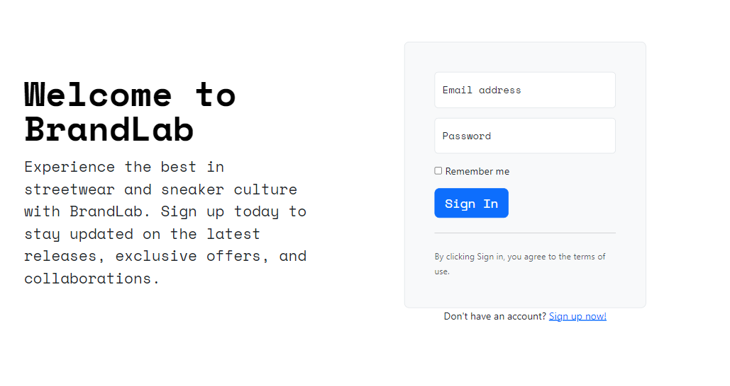
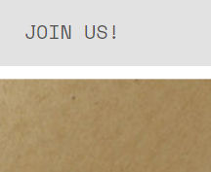
Bootstrap - Heroes

Slide 15

Bootstrap - Heroes

Slide 16
Shopping Carts
1980 CLOTHING STYLE BRAND 1980 CLOTHING STYLE BRAND 1980 CLOTHING STYLE BRAND 1980 CLOTHING STYLE BRAN
(Add to carts)
ND 1980 CLOTHING STYLE BRAND 1980 CLOTHING STYLE BRAND 1980 CLOTHING STYLE BRAND 1980 CLOTHING STYLE BR

Slide 17
Bootstrap - Checkout

Slide 18
Checkout Page
1980 CLOTHING STYLE BRAND 1980 CLOTHING STYLE BRAND 1980 CLOTHING STYLE BRAND 1980 CLOTHING STYLE BRAN
ND 1980 CLOTHING STYLE BRAND 1980 CLOTHING STYLE BRAND 1980 CLOTHING STYLE BRAND 1980 CLOTHING STYLE BR

Slide 19
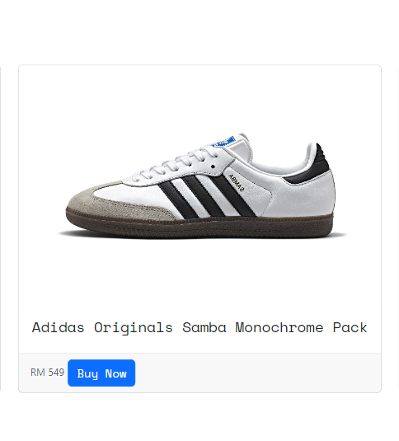
Bootstrap - Checkout

Slide 20
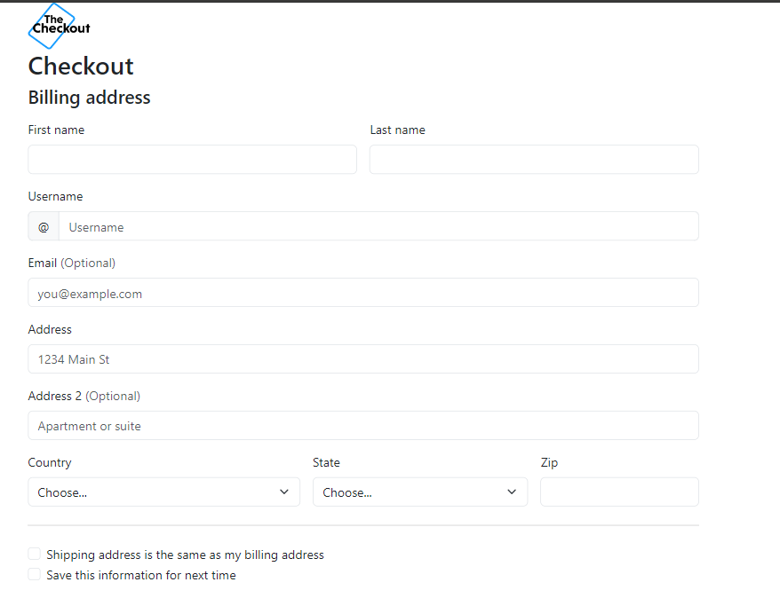
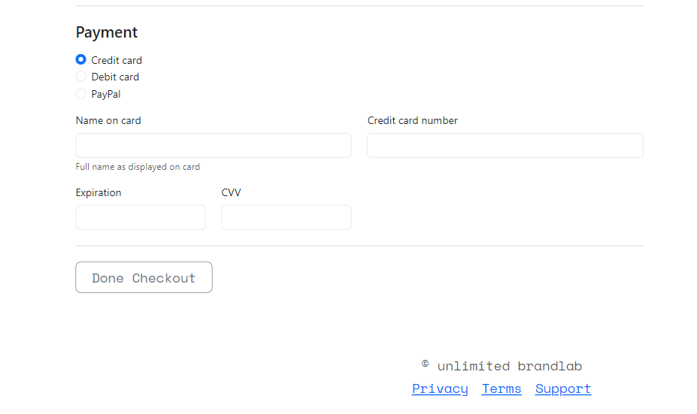
Bootstrap - Checkout

Slide 21
Why choose our website?
1980 CLOTHING STYLE BRAND 1980 CLOTHING STYLE BRAND 1980 CLOTHING STYLE BRAND 1980 CLOTHING STYLE BRAN
ND 1980 CLOTHING STYLE BRAND 1980 CLOTHING STYLE BRAND 1980 CLOTHING STYLE BRAND 1980 CLOTHING STYLE BR

Slide 22
Why our website?
Easy Management
Aesthetic Appeal
Our website is designed for effortless content and product management, ensuring administrators can update and maintain it without technical hurdles
We prioritize visual attractiveness, ensuring our website captivates visitors with sleek design elements and stunning visuals.
Enhanced User Experience
Our focus is on providing visitors with a seamless browsing experience, making it easy to navigate, discover products, and enjoy a visually pleasing interface.

Slide 23
Conclusion
1980 CLOTHING STYLE BRAND 1980 CLOTHING STYLE BRAND 1980 CLOTHING STYLE BRAND 1980 CLOTHING STYLE BRAN
In conclusion, our website offers a unique blend of streetwear and sneaker culture, providing customers with access to a diverse range of brands and styles. With easy management, aesthetic appeal, and exclusive member benefits, including discounts and special offers delivered straight to your inbox, there's no better place to shop for the latest trends in urban fashion. Join us today and elevate your wardrobe with ease and style.
ND 1980 CLOTHING STYLE BRAND 1980 CLOTHING STYLE BRAND 1980 CLOTHING STYLE BRAND 1980 CLOTHING STYLE BR

Slide 24
THANKS!
1980 CLOTHING STYLE BRAND 1980 CLOTHING STYLE BRAND 1980 CLOTHING STYLE BRAND 1980 CLOTHING STYLE BRAN
ND 1980 CLOTHING STYLE BRAND 1980 CLOTHING STYLE BRAND 1980 CLOTHING STYLE BRAND 1980 CLOTHING STYLE BR

